Slide 1
UPPER SIXTH ARTS
GEOGRAPHY
Lesson 18
Theories of Population and Resources: Malthus and Boserup
Notes:
Good morning, class, and welcome to our geography lesson. I am your geography teacher, Mr Kamdem. Today we are starting Lesson 18: Theories of Population and Resources: Malthus and Boserup.

Slide 2
CLASS INFO
Class, Chapter and Duration
Class | Upper Sixth Arts
Chapter | Module 4: Understanding and managing population dynamics across the world in general and Cameroon in particular
Duration | 2 periods (2 × 50 minutes)
Notes:
This lesson is for Upper Sixth Arts. It belongs to Module 4: Understanding and managing population dynamics across the world in general and Cameroon in particular. We shall need 2 periods to cover it.

Slide 3
IDENTIFICATION
Lesson Identification
Topic | Population Growth and Resources
Sub-topic | Theories of Population Growth and Resources
Lesson | Lesson 18: Theories of Population and Resources: Malthus and Boserup
Notions / Concepts | Malthus, geometric growth, arithmetic growth, positive checks, preventive checks, Boserup, agricultural intensification.
Syllabus focus | General views; Malthus's and Boserup's theories; their views on growth and development; strengths and weaknesses.
Competence | Learners are able to compare the theories of Malthus and Boserup and apply them today.
Notes:
Our topic is Population Growth and Resources, and the sub-topic is Theories of Population Growth and Resources. The key notions we shall use today are: malthus, geometric growth, arithmetic growth, positive checks, preventive checks, Boserup, agricultural intensification. At the end, you should be able to do this: learners are able to compare the theories of Malthus and Boserup and apply them today.

Slide 4

HOMEWORK CORRECTION
Correction of the Homework
Question (Lesson 17: Overpopulation, Underpopulation and Optimum Population):
Is Cameroon over-, under- or optimally populated? Write a paragraph with evidence.
Notes:
Before we start the new lesson, let us correct the homework I gave you at the end of Lesson 17: Overpopulation, Underpopulation and Optimum Population. The question was: Is Cameroon over-, under- or optimally populated? Write a paragraph with evidence. Take out your exercise books.

Slide 5
HOMEWORK CORRECTION
Correction: Possible Answer
Cameroon as a whole is closer to underpopulation (rich resources, 59 people/km²), but some areas such as the Mandara Mountains and the Western Highlands show signs of overpopulation (land shortage, erosion, migration).
Notes:
Here is a good answer. Cameroon as a whole is closer to underpopulation (rich resources, 59 people/km²), but some areas such as the Mandara Mountains and the Western Highlands show signs of overpopulation (land shortage, erosion, migration). Compare it with your own answer and correct your work in red.

Slide 6
LESSON PLAN
Lesson Plan
Correction of the homework
Objectives and recall
Real-life situation and action to take
Learning activities
Board summary
Evaluation, remediation and homework
Notes:
Here is the plan of our lesson today. First, we shall correct the homework. Then we shall look at the objectives and recall what you already know. After that, we shall study a situation from real life and the action to take, and do the learning activities. Finally, we shall copy the board summary, do the evaluation and the remediation, and I will give you the homework.

Slide 7
OBJECTIVES
Objectives
By the end of this lesson, you should be able to:
Explain Malthus's theory.
Explain Boserup's theory.
Evaluate both theories with examples.
Notes:
By the end of this lesson, you should be able to do three things. Number 1: explain Malthus's theory. Number 2: explain Boserup's theory. Number 3: evaluate both theories with examples.

Slide 8
PREVIOUS KNOWLEDGE
Previous Knowledge
Population can overshoot carrying capacity.
Technology can raise food production.
Notes:
Let us first remember what you already know. Population can overshoot carrying capacity. Technology can raise food production. Keep this in mind, because we shall build on it today.

Slide 9
REAL-LIFE SITUATION
Situation in Real Life
An economist says that population growth will lead to famine. A farmer in the Mandara Mountains says that when land became scarce, his ancestors built terraces and produced more food.
Notes:
Listen carefully to this situation from real life. An economist says that population growth will lead to famine. A farmer in the Mandara Mountains says that when land became scarce, his ancestors built terraces and produced more food. Think about it, because I am going to ask you some questions.

Slide 10
REAL-LIFE SITUATION
Situation: Question 1
What is the problem in the situation?
Notes:
Question 1: What is the problem in the situation? Think for a moment, then raise your hand to answer.

Slide 11
REAL-LIFE SITUATION
Answer
They disagree on whether population growth is good or bad.
Notes:
Good. They disagree on whether population growth is good or bad.

Slide 12
REAL-LIFE SITUATION
Situation: Question 2
Whose idea is the economist's?
Notes:
Question 2: Whose idea is the economist's? Think for a moment, then raise your hand to answer.

Slide 13
REAL-LIFE SITUATION
Answer
Malthus's pessimistic theory.
Notes:
Good. Malthus's pessimistic theory.

Slide 14
REAL-LIFE SITUATION
Situation: Question 3
Whose idea is the farmer's?
Notes:
Question 3: Whose idea is the farmer's? Think for a moment, then raise your hand to answer.

Slide 15
REAL-LIFE SITUATION
Possible Answer
Boserup's optimistic theory.
Notes:
Good. Boserup's optimistic theory.

Slide 16
ACTION TO TAKE
Action to Take
Evaluate theories of population and resources and apply them to Cameroon.
Notes:
From this situation, the action we are working towards in this lesson is the following: evaluate theories of population and resources and apply them to Cameroon.

Slide 17
JUSTIFICATION
Justification of the Lesson
This lesson helps us to debate whether population growth is a problem or a driver of progress.
Notes:
Why is this lesson important for you? This lesson helps us to debate whether population growth is a problem or a driver of progress.

Slide 18
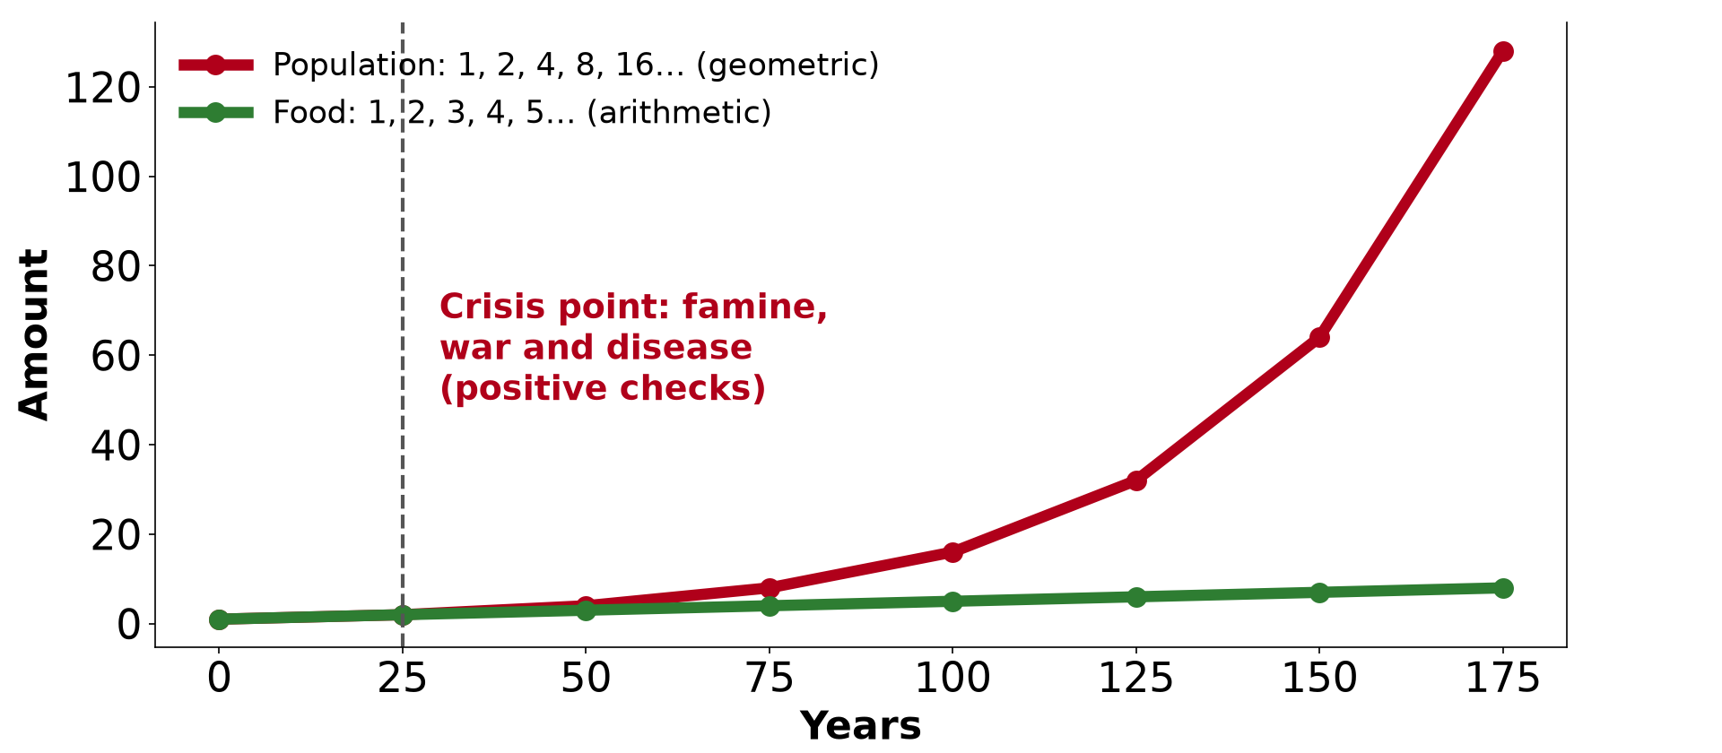
1. MALTHUS'S THEORY
Activity 1
Malthus: population outgrows food.
Notes:
Activity 1. Look carefully at this diagram: malthus: population outgrows food. Observe every detail before I ask the question.

Slide 19
1. MALTHUS'S THEORY
Activity 1: Question
According to Malthus, how do population and food grow?
Notes:
Here is the question for Activity 1: According to Malthus, how do population and food grow? Take one minute to think and write your answer in your rough notebook.

Slide 20
1. MALTHUS'S THEORY
Activity 1: Answer
Population grows geometrically (1, 2, 4, 8); food grows arithmetically (1, 2, 3, 4).
Notes:
Let us check the answer together. Population grows geometrically (1, 2, 4, 8); food grows arithmetically (1, 2, 3, 4).

Slide 21

1. MALTHUS'S THEORY
Activity 2
Drought and failed crops.
Notes:
Activity 2. Look carefully at this picture: drought and failed crops. Observe every detail before I ask the question.

Slide 22
1. MALTHUS'S THEORY
Activity 2: Question
What are Malthus's positive checks?
Notes:
Here is the question for Activity 2: What are Malthus's positive checks? Take one minute to think and write your answer in your rough notebook.

Slide 23
1. MALTHUS'S THEORY
Activity 2: Answer
Famine, war and disease that raise deaths.
Notes:
Let us check the answer together. Famine, war and disease that raise deaths.

Slide 24
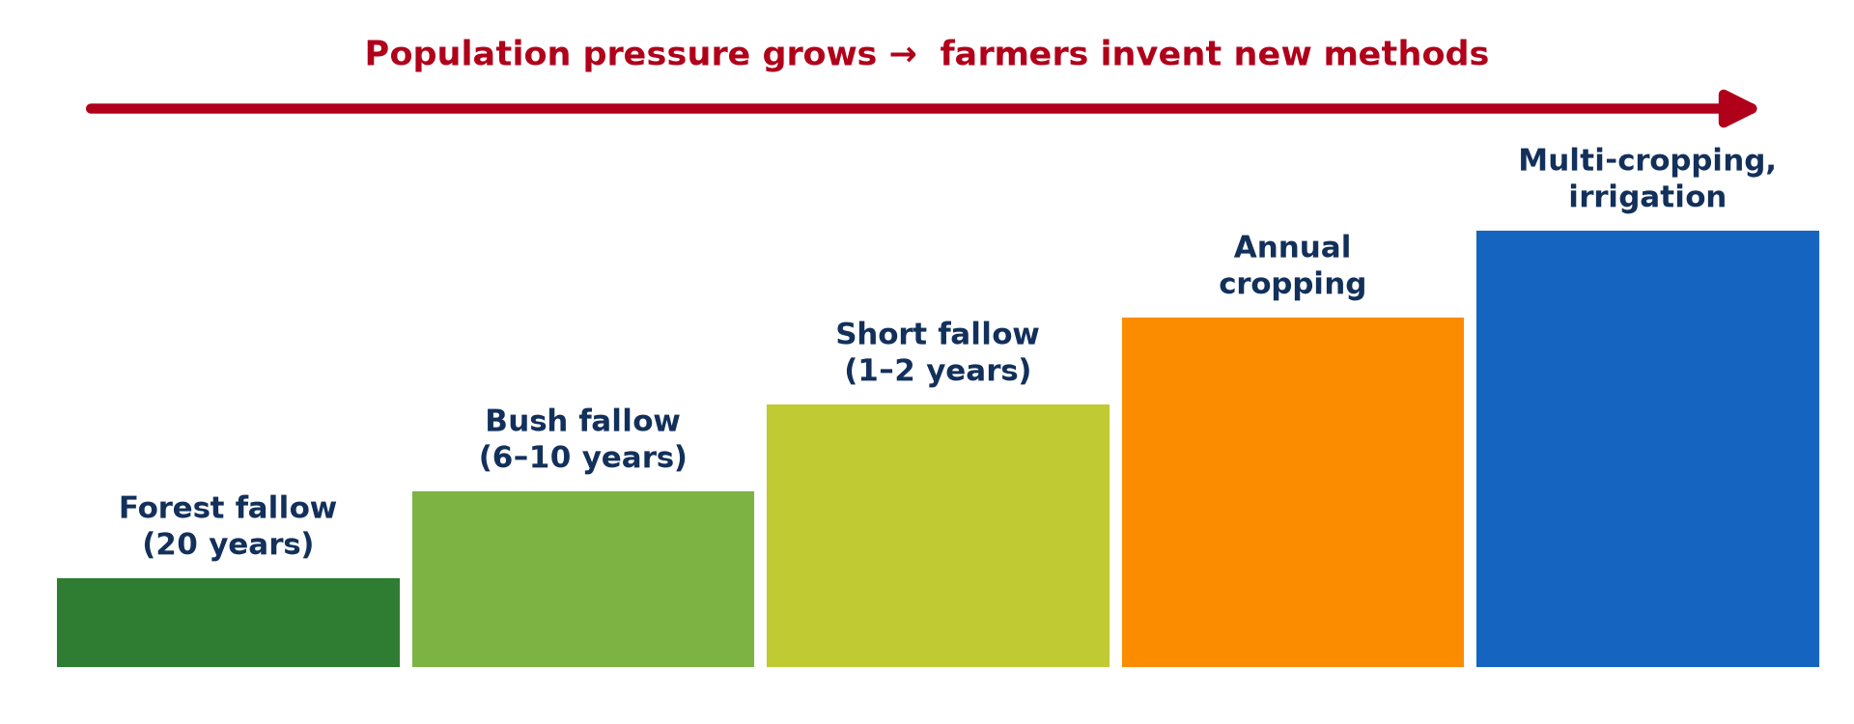
2. BOSERUP'S THEORY
Activity 3
Boserup: pressure leads to new methods.
Notes:
Activity 3. Look carefully at this diagram: boserup: pressure leads to new methods. Observe every detail before I ask the question.

Slide 25
2. BOSERUP'S THEORY
Activity 3: Question
According to Boserup, what does population pressure cause?
Notes:
Here is the question for Activity 3: According to Boserup, what does population pressure cause? Take one minute to think and write your answer in your rough notebook.

Slide 26
2. BOSERUP'S THEORY
Activity 3: Answer
Farmers invent new methods to produce more food.
Notes:
Let us check the answer together. Farmers invent new methods to produce more food.

Slide 27

2. BOSERUP'S THEORY
Activity 4
Terraces on steep slopes.
Notes:
Activity 4. Look carefully at this picture: terraces on steep slopes. Observe every detail before I ask the question.

Slide 28
2. BOSERUP'S THEORY
Activity 4: Question
How do terraces support Boserup's theory?
Notes:
Here is the question for Activity 4: How do terraces support Boserup's theory? Take one minute to think and write your answer in your rough notebook.

Slide 29
2. BOSERUP'S THEORY
Activity 4: Answer
Pressure on land led farmers to farm slopes intensively.
Notes:
Let us check the answer together. Pressure on land led farmers to farm slopes intensively.

Slide 30

3. STRENGTHS AND WEAKNESSES
Activity 5
High-yield rice fields.
Notes:
Activity 5. Look carefully at this picture: high-yield rice fields. Observe every detail before I ask the question.

Slide 31
3. STRENGTHS AND WEAKNESSES
Activity 5: Question
How does the Green Revolution challenge Malthus?
Notes:
Here is the question for Activity 5: How does the Green Revolution challenge Malthus? Take one minute to think and write your answer in your rough notebook.

Slide 32
3. STRENGTHS AND WEAKNESSES
Activity 5: Answer
New seeds and irrigation raised food faster than population.
Notes:
Let us check the answer together. New seeds and irrigation raised food faster than population.

Slide 33
BOARD SUMMARY
Board Summary
Topic: Population Growth and Resources
Sub-topic: Theories of Population Growth and Resources
Lesson 18: Theories of Population and Resources: Malthus and Boserup
Notes:
Now we are going to copy the board summary. Write the title and the headings neatly in your notebooks. I will give you enough time for each slide, so do not rush.

Slide 34
BOARD SUMMARY
1. General Views on Population and Resources
There are two main views:
Pessimistic view: Population growth is a threat because resources are limited. Growth leads to famine and poverty.
Notes:
Let us copy General Views on Population and Resources. There are two main views. On this slide we have Pessimistic view. Write each point on a new line, with the key term first, and explain it in your own words when we revise. When you finish, we go to the next slide.

Slide 35
BOARD SUMMARY
1. General Views on Population and Resources (continued)
Optimistic view: Population growth stimulates technology and development. People are a resource that creates new solutions.
Notes:
We continue with General Views on Population and Resources. On this slide we have Optimistic view. Write each point on a new line, with the key term first, and explain it in your own words when we revise.

Slide 36
BOARD SUMMARY
2. Malthus's Theory (1798)
Thomas Malthus stated that:
Main idea: Population grows geometrically (1, 2, 4, 8…) while food grows arithmetically (1, 2, 3, 4…). Population will therefore outgrow food.
Notes:
Let us copy Malthus's Theory (1798). Thomas Malthus stated that. On this slide we have Main idea. Write each point on a new line, with the key term first, and explain it in your own words when we revise. When you finish, we go to the next slide.

Slide 37
BOARD SUMMARY
2. Malthus's Theory (1798) (continued)
Checks: Positive checks (famine, disease, war) raise deaths. Preventive checks (late marriage, abstinence) lower births.
Strengths and weaknesses: Famines in the Sahel and Ethiopia seem to support him. But he underestimated technology, trade and the fall in birth rates.
Notes:
We continue with Malthus's Theory (1798). On this slide we have Checks and Strengths and weaknesses. Write each point on a new line, with the key term first, and explain it in your own words when we revise.

Slide 38
BOARD SUMMARY
2. Malthus's Theory (1798)
Illustration: Malthus's theory
Notes:
Now draw this illustration in your notebook: malthus's theory. Give it a title and label it clearly.

Slide 39
BOARD SUMMARY
3. Boserup's Theory (1965)
Ester Boserup stated that:
Main idea: "Necessity is the mother of invention": population pressure forces people to intensify farming. Fallow is shortened and new techniques are adopted.
Notes:
Let us copy Boserup's Theory (1965). Ester Boserup stated that. On this slide we have Main idea. Write each point on a new line, with the key term first, and explain it in your own words when we revise. When you finish, we go to the next slide.

Slide 40
BOARD SUMMARY
3. Boserup's Theory (1965) (continued)
Examples: Terraces in the Mandara Mountains and irrigation in Asia increased food production. The Green Revolution supports her view.
Notes:
We continue with Boserup's Theory (1965). On this slide we have Examples. Write each point on a new line, with the key term first, and explain it in your own words when we revise. When you finish, we go to the next slide.

Slide 41
BOARD SUMMARY
3. Boserup's Theory (1965) (continued)
Strengths and weaknesses: It explains intensification in crowded areas. But it ignores environmental limits and societies that cannot innovate fast enough.
Notes:
We continue with Boserup's Theory (1965). On this slide we have Strengths and weaknesses. Write each point on a new line, with the key term first, and explain it in your own words when we revise.

Slide 42
BOARD SUMMARY
3. Boserup's Theory (1965)
Illustration: Boserup's theory
Notes:
Now draw this illustration in your notebook: boserup's theory. Give it a title and label it clearly.

Slide 43
FORMATIVE EVALUATION
Evaluation 1
Compare the views of Malthus and Boserup.
Notes:
Now let us check what you have understood. Question 1: Compare the views of Malthus and Boserup. Answer in your exercise book.

Slide 44
FORMATIVE EVALUATION
Expected Answer
Malthus: population outgrows food and causes crises. Boserup: pressure leads to new methods and more food.
Notes:
The expected answer is: malthus: population outgrows food and causes crises. Boserup: pressure leads to new methods and more food. If you got it right, well done.

Slide 45
FORMATIVE EVALUATION
Evaluation 2
Give one weakness of Malthus's theory.
Notes:
Now let us check what you have understood. Question 2: Give one weakness of Malthus's theory. Answer in your exercise book.

Slide 46
FORMATIVE EVALUATION
Expected Answer
He did not foresee technology and trade that increased food.
Notes:
The expected answer is: he did not foresee technology and trade that increased food. If you got it right, well done.

Slide 47
REMEDIATION
Remediation
Fill in the blanks:
Malthus said food grows ______.
Famine and war are Malthus's ______ checks.
Boserup said pressure leads to ______.
Notes:
For those who need more practice, fill in the blanks in your exercise book. The answers are: number 1, arithmetically; number 2, positive; number 3, innovation (intensification).

Slide 48
HOMEWORK
Homework
Write a debate: "Population growth is a problem for Cameroon." Give two arguments for and two against.
Notes:
For your homework: Write a debate: "Population growth is a problem for Cameroon." Give two arguments for and two against. We shall correct it at the beginning of our next lesson.

Slide 49
NEXT LESSON
Next Lesson
Our next lesson will be on:
Further Study 1: Population Change in Cameroon
Notes:
Our next lesson will be on Further Study 1: Population Change in Cameroon. Thank you for your attention, and see you next time.

Slide 50
BILINGUAL GAME
Bilingual Game (Jeu Bilingue)
English | Français
Theory | La théorie
Famine | La famine
Check | Le frein
Innovation | L'innovation
Intensification | L'intensification
Pessimist | Pessimiste
Notes:
Let us play the bilingual game. I say a word in English, and you give me the French word. Then we do the reverse.

Slide 51
LOGBOOK
Official Logbook (1/2)
Module / Topic | Population Growth and Resources
Lesson Title | Lesson 18: Theories of Population and Resources: Malthus and Boserup
Expected Learning Outcomes | Explain Malthus's theory. Explain Boserup's theory. Evaluate both theories with examples.
Competence | Learners are able to compare the theories of Malthus and Boserup and apply them today.
Notes:
I record this information in the official logbook of the class after the lesson.

Slide 52
LOGBOOK
Official Logbook (2/2)
Matter Taught | General Views on Population and Resources; Malthus's Theory (1798); Boserup's Theory (1965).
Evaluation | Formative evaluation and remediation exercise.
Homework | Write a debate: "Population growth is a problem for Cameroon." Give two arguments for and two against.
Enrolment / Present / Absent | ____ / ____ / ____
Achievement | To be completed after the lesson.
Notes:
I complete the second page of the logbook: the matter taught, the evaluation, the homework and the attendance.

Slide 53
TEACHER'S NOTE
Teacher's Note
Timing: Homework correction, plan, objectives 8 min | Recall, situation, action 10 min | 5 activities 30 min | Board summary (copying) 30 min | Evaluation, remediation 10 min | Homework, next lesson 5 min | Logbook 7 min
Without the projector (Activity 1): write the two series.
Without the projector (Activity 2): list preventive checks too.
Without the projector (Activity 3): draw the staircase.
Without the projector (Activity 4): mention the Mandara terraces.
Without the projector (Activity 5): discuss food production today.
Notes:
This slide is for me, the teacher: it gives the timing of the lesson and what to do if the projector is not available.

Slide 54
REFERENCES
References
National Geography Syllabus, MINESEC/IGE/IP-SS, 2019 — Module 4 (Population Geography).
Photo, Activity 2: “Imagine a world without trees” by aloshbennett, CC BY 2.0, via Flickr (https://www.flickr.com/photos/13203757@N00/3480223314)
Photo, Activity 4: “Terraced Hillside” by AdamCohn, CC BY-NC-ND 2.0, via Flickr (https://www.flickr.com/photos/96142515@N00/6311042523)
Photo, Activity 5: “A woman harvesting rice, Barotse floodplain, Zambia. Photo by Georgina” by WorldFish, CC BY-NC-ND 2.0, via Flickr (https://www.flickr.com/photos/61545321@N06/7848727138)
Diagrams and animations: drawn for this lesson (Geography Department).
Notes:
These are the references and picture credits used to prepare this lesson.

